Slide 1
UNIT 8

Slide 2
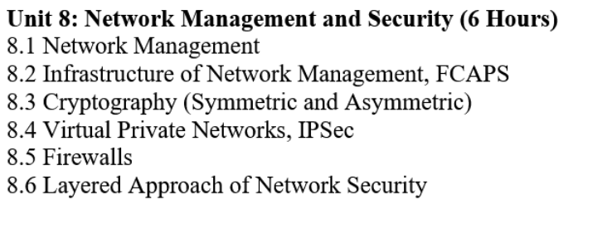

Slide 3
Network Management
Network management is the process of administering, operating, and maintaining computer networks.
It helps ensure networks run efficiently, securely, and reliably.
As networks grow in size and complexity, effective management becomes essential.
Tools, Protocols, and Processes for Managing Computer Networks

Slide 4
What is a Computer Network?
A computer network connects two or more devices.
Devices can include:
Computers
Servers
Routers
Switches
Mobile devices
Networks enable data sharing, communication, and resource access.
Need for Network Management
Growth from a few devices to hundreds or thousands increases complexity.
Enterprise networks support:
Business applications
End users
Cloud and remote services
Poor management can cause:
Downtime
Security risks
Performance issues

Slide 5
Objectives of Network Management
Ensure network availability
Improve network performance
Maintain network security
Provide network visibility
Reduce downtime and operational costs
Key Components of Network Management
Network management includes the following capabilities:
Network performance monitoring
Network monitoring
Network maintenance and troubleshooting
Network configuration management
Network provisioning
Network automation

Slide 6
Network Performance Monitoring
Measures network speed and efficiency.
Monitors:
Bandwidth usage
Latency
Packet loss
Helps identify performance bottlenecks.
Ensures applications run smoothly.
Network Monitoring
Continuous observation of network devices and links.
Detects:
Device failures
Traffic overload
Security threats
Uses tools like:
SNMP
Network dashboards
Enables quick response to issues.

Slide 7
Network Maintenance and Troubleshooting
Regular maintenance keeps the network stable.
Troubleshooting identifies and fixes problems.
Common activities:
Fault detection
Root cause analysis
Hardware and software updates
Reduces downtime and service disruption.
Network Configuration Management
Manages network device configurations.
Includes:
Setting IP addresses
Managing routing and switching rules
Ensures consistency across devices.
Helps in backup and recovery of configurations.

Slide 8
Network management infrastructure
Network management infrastructure refers to the hardware, software, protocols, and people involved in managing a network.
It provides the foundation for monitoring, controlling, and optimizing network operations.
A well-designed infrastructure ensures reliability, performance, and security.
Components of Network Management Infrastructure
The infrastructure consists of:
Network devices
Management stations
Network management software
Management protocols
Databases and logs
Network administrators

Slide 9
Network Devices
Physical and logical components of the network.
Examples:
Routers
Switches
Servers
Firewalls
Access points
These devices generate data that is monitored and managed.
Management Stations (NMS)
Central system used to manage the entire network.
Performs:
Monitoring
Configuration
Fault detection
Runs Network Management Software.
Example: Network Operations Center (NOC).

Slide 10
Network Management Software
Tools used to control and monitor network devices.
Functions:
Performance analysis
Fault management
Security monitoring
Examples:
SolarWinds
Nagios
Zabbix
PRTG
Network Management Protocols
Enable communication between managed devices and management stations.
Common protocols:
SNMP (Simple Network Management Protocol)
NETCONF
REST APIs
ICMP
Used for data collection, alerts, and configuration

Slide 11
Managed Devices and Agents
Managed devices contain agents.
Agents:
Collect performance data
Send alerts to NMS
Respond to management requests
Examples: SNMP agents on routers and switches.
Management Information Base (MIB)
Database that stores network management information.
Contains:
Device statistics
Configuration details
Performance data
Used by SNMP to retrieve and update data.

Slide 12
Databases and Log Systems
Store historical and real-time data.
Includes:
Event logs
Traffic logs
Security logs
Helps in:
Trend analysis
Troubleshooting
Auditing
Network Administrators
Human component of the infrastructure.
Responsibilities:
Network monitoring
Configuration and maintenance
Security management
Troubleshooting
Make decisions based on collected data.

Slide 13
Network Management Architecture
Centralized Management
Single NMS controls all devices.
Distributed Management
Multiple NMS systems manage different network segments.
Choice depends on network size and complexity.
Security in Network Management Infrastructure
Secure access to management systems.
Includes:
Authentication and authorization
Encrypted protocols
Role-based access control
Prevents unauthorized network changes.

Slide 14
Benefits of Proper Infrastructure
Efficient network operations
Faster fault detection and resolution
Improved performance and availability
Enhanced security and compliance

Slide 15
The FCAPS Model
The International Organization for Standardization (ISO) released the FCAPS model in the early 1980s.
The main objective of creating this model was to guide the development of network management solutions and frameworks.
It provides a proactive, structured approach for administrators to monitor, manage, and optimize network infrastructure performance and security.
The FCAPS model aims to provide a guide for developers and operators on how to manage a networked environment.
This model approaches management holistically, defining five working levels: Fault, Configuration, Accounting, Performance, and Security.

Slide 16
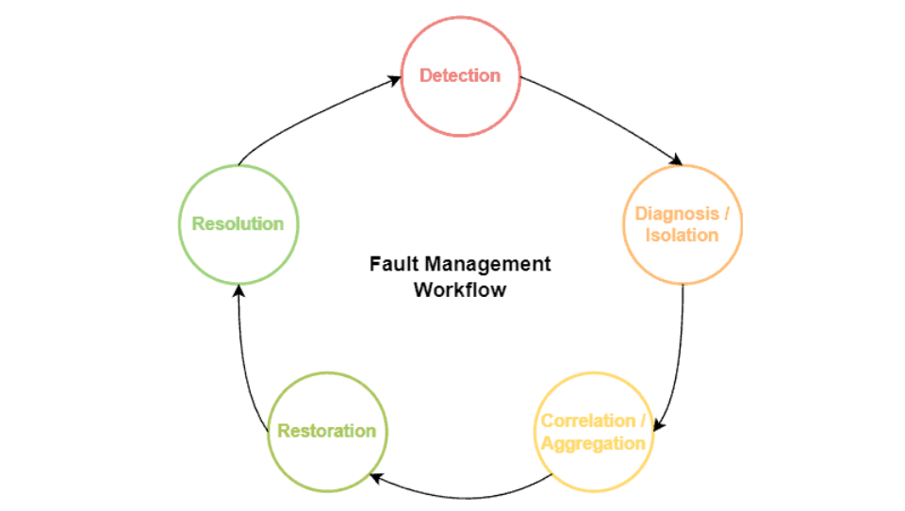
1. Fault Management
In a network, it is not unusual for faults happening.
Faults will eventually occur, even adopting several preventive actions against them.
In this way, fault management in FCAPS aims to detect these faults and mitigate their consequences, in addition to recovering the networked system.
To deal with faults, the FCAPS model proposes a five-step cycled workflow:

Slide 17
In the fault management workflow, detection means the ability to identify that something goes wrong in the system.
Based on the detection, the next step consists of verifying the part of the system affected by the detected fault, which we call diagnosis and isolation.
Thus, potential problems and consequences of the fault are measured in the step called correlation and aggregation.
After that, the developers and operators can start working on mitigating and solving the problem, making the system fully functional.
We call this step restoration.
Finally, in the resolution step, the system is checked to confirm that the fault got fixed.

Slide 18
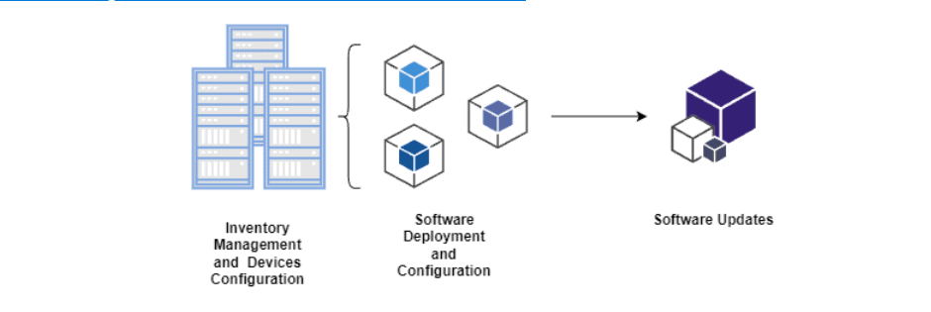
3.Configuration management deals with hardware and software:
On the hardware side, for example, we have inventory management that comprises all the machinery available for a networked system.
Also, we have allocation management refereeing to the best physical placement of hardware resources and upgrading and scaling management to provide the proper amount of computational resources for the networked system.
On the software side, we should attempt to find the best hardware machine for running the required programs regarding execution support and performance.
Moreover, operators should manage the running software versioning, keeping it updated.
Finally, configuring the system also includes defining which operators will have access to each part of it.

Slide 19
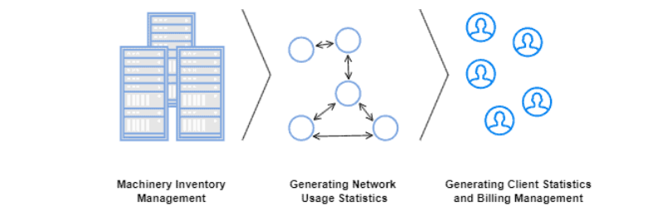
3. Accounting Management
Accounting management aims to optimize the distribution of resources among the network clients.
Thus, we can understand accounting management as administrative tasks involving network managers, operators, and clients.
The following figure depicts, on a high level, some tasks of accounting management:

Slide 20
A particular task of accounting management is creating an inventory of all available network resources.
In this way, while routines executed in configuration management update the machinery in this inventory, the accounting management focuses on updating the inventory itself.
Accounting management also works on billing management.
So, to do that, operators and managers typically generate statistics on clients’ registers, their network usage, and the impact of different network usage profiles.
Finally, it is also a task of accounting management to determine the proper permissions and access rights of each client in the network.

Slide 21
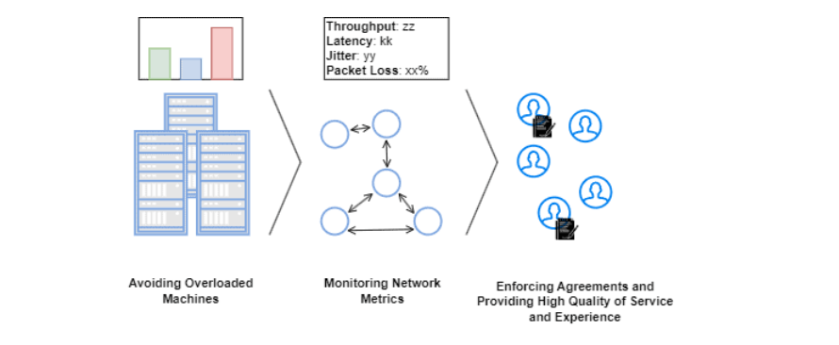
4. Performance Management
As the name suggests, performance management works on monitoring and trying to improve the overall performance of a network.
We can see performance improvements in different manners, such as maximizing throughput, minimizing latency, and avoiding bottlenecks.
The next figure show some usual monitoring routines and performance improvement actions of performance management:

Slide 22
The central objective of performance management is improving the provided quality of service and experience for the clients.
But, more than that, performance management enables the managers and operators to understand the network necessities as the number of clients grows or decreases or the service level agreements change.

Slide 23
5.Security Management
The main idea of security management is controlling the access to the resources and equipment of a network, mainly the sensitive ones.
By avoiding improper accesses and modifications in the network, the operators and managers both keep the network active and the clients secure.
Examples of typical attacks that may occur in a network are denial of service, man-in-the-middle, and DNS poisoning, among others.
Security management starts in the core network itself. Relevant actions to securing a network consist of deploying network functions tailored to identify and mitigate attacks.
Security function examples are intrusion detection and prevention systems, firewalls, antivirus, etc. The figure below shows a deployment of these functions in a simple network:

Slide 24
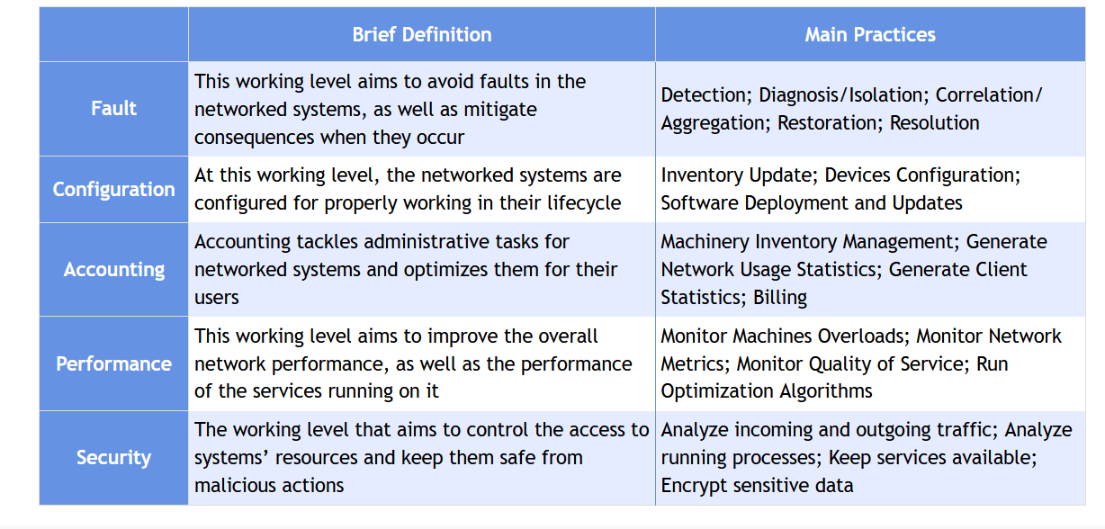

Slide 25
Virtual Private Network (VPN)
VPN
A Virtual Private Network (VPN) is a technology that creates a secure and encrypted connection over a public network such as the Internet.
It allows users to send and receive data as if their device were directly connected to a private network.
VPNs are widely used for secure communication, privacy, and remote access.
Why VPN is Needed
Public networks (Internet, public Wi-Fi) are not secure.
VPN protects:
Confidential data
User identity
Network resources
Common use cases:
Remote work
Secure business communication
Accessing private network resources

Slide 26
How VPN Works
VPN creates a secure tunnel between the user and the VPN server.
Data is:
Encrypted before transmission
Decrypted at the destination
The user’s IP address is hidden and replaced by the VPN server’s IP.
Key Components of VPN
VPN Client – Software on the user device
VPN Server – Authenticates users and manages connections
Encryption Protocols – Secure data transfer
Authentication Mechanism – Verifies user identity
Tunneling Protocol – Creates secure path for data

Slide 27
Types of VPN
1. Remote Access VPN
Allows individual users to connect to a private network remotely.
Common for employees working from home.
Example: Employee connecting to company network.
2. Site-to-Site VPN
Connects two or more networks securely.
Used by organizations with multiple branches.
Example: Head office ↔ Branch office.
VPN Tunneling Protocols
PPTP (Point-to-Point Tunneling Protocol)
Fast but less secure
L2TP (Layer 2 Tunneling Protocol)
More secure when combined with IPsec
IPsec (Internet Protocol Security)
Strong security, widely used
SSL/TLS VPN
Uses web browsers, flexible and secure
OpenVPN
Open-source, highly secure and reliable

Slide 28
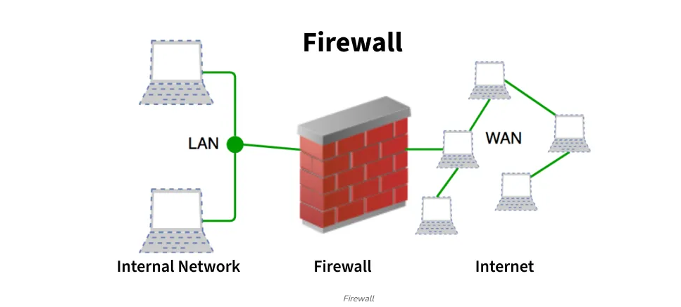
Firewall in Computer Network
A firewall is a network security system, available as hardware or software, that monitors and controls incoming and outgoing traffic based on predefined rules.
It acts like a security guard, filtering data packets to either:
Accept: Allow the traffic.
Reject: Block with an error response.
Drop: Block silently without response.

Slide 29
Importance of Firewalls
A firewall is the first line of defense in cybersecurity, acting as a security barrier between internal systems and external networks.
It forces all traffic through a single checkpoint, where data packets are monitored, filtered, and either allowed or blocked based on predefined rules. Firewalls are essential because they:
Prevent Unauthorized Access: Like a locked door with a guard, only trusted users and traffic are allowed through.
Block Malicious Traffic: Harmful data such as viruses, phishing attempts, or denial-of-service (DoS) attacks are stopped before reaching the system.
Protect Sensitive Information: Safeguards personal and business data from theft or accidental leaks.
Control Network Usage: Enforces policies such as parental controls, workplace restrictions, or government filtering.
Mitigate Insider Risks: Detects suspicious applications or data exfiltration attempts from within the network.

Slide 30
By combining prevention, monitoring, and control, firewalls provide customizable and comprehensive protection against both external and internal threats.
Working of Firewall
A firewall inspects all incoming and outgoing traffic and decide whether to allow or block it.
All data packets entering or leaving the network must first pass through the firewall.
The firewall examines each packet against predefined security rules set by the organization.
If the packet matches safe rules, it is allowed; if it is suspicious, blacklisted, or contains malicious content, it is blocked.
Blocked or unusual traffic is recorded in logs, and real-time alerts may be generated for serious threats.
Since it is not possible to define every rule, the firewall applies a default policy (accept, reject, or drop).
Setting the default policy to drop or reject is considered best practice to prevent unauthorized access.

Slide 31
Types of Firewall
Firewalls can be categorized based on their generation.
1) Network Placement
Packet Filtering Firewall
Stateful Inspection Firewall
Proxy Firewall (Application Level)
Circuit-Level Gateway
Web Application Firewall (WAF)
Next-Generation Firewall (NGFW)
2) Systems Protected
Network Firewall
Host-Based Firewall

Slide 32
3) Data Filtering Method
Perimeter Firewall
Internal Firewall
Distributed Firewall
4) Form Factors
Hardware Firewall
Software Firewall

Slide 33
IPSec (Internet Protocol Security)
IPSec (Internet Protocol Security) is a set of protocols used to secure communication over an IP network by authenticating and encrypting each IP packet in a communication session.
It works at the Network Layer (Layer 3) of the OSI model.
IPSec is widely used in:
VPNs (Virtual Private Networks)
Site-to-Site VPN
Remote Access VPN
Secure communication between servers

Slide 34
Objectives of IPSec
IPSec provides the following security services:
Confidentiality – Encrypts data so unauthorized users cannot read it.
Integrity – Ensures data is not modified during transmission.
Authentication – Verifies the identity of the sender.
Anti-replay protection – Prevents attackers from reusing captured packets
IPSec Protocols
IPSec uses two main protocols:
A. Authentication Header (AH)
Provides authentication and integrity.
Does NOT provide encryption.
Protects against packet modification.
Adds a header to the IP packet.
Features:
Ensures message integrity
Provides sender authentication
Protects against replay attacks

Slide 35
B. Encapsulating Security Payload (ESP)
Provides encryption + authentication.
Most commonly used IPSec protocol.
Protects confidentiality, integrity, and authentication.
Features:
Encrypts payload
Ensures integrity
Supports anti-replay protection
ESP is widely used in VPN implementations.

Slide 36
Layered Approach of Network Security
1. Physical Layer Security
Protects hardware and physical infrastructure.
Measures:
CCTV surveillance
Biometric or ID card access
Locked server rooms
Security guards
Environmental controls (fire alarms, temperature control)
Purpose: Prevent unauthorized physical access to network devices and servers.
The layered approach of network security, also called Defense in Depth, is a strategy where multiple security controls are placed at different layers of a network to protect data and systems.
If one security layer fails, other layers continue to provide protection.

Slide 37
2. Perimeter Security (Network Edge)
Protects the boundary between internal network and external networks (Internet).
Measures:
Firewalls
Proxy servers
Intrusion Detection Systems (IDS)
Intrusion Prevention Systems (IPS)
VPN gateways
Purpose: Block unauthorized external access and filter incoming/outgoing traffic.
3. Network Layer Security
Secures internal network traffic.
Measures:
Network segmentation (VLANs)
Access Control Lists (ACLs)
Network Access Control (NAC)
Secure routing protocols
IPsec encryption
Purpose: Limit movement within the network and prevent internal attacks.

Slide 38
4. Host (Endpoint) Security
Protects individual devices like computers and servers.
Measures:
Antivirus / Anti-malware
Endpoint Detection and Response (EDR)
Host-based firewall
Patch management
Disk encryption
Purpose: Protect devices from malware and unauthorized access.
5. Application Layer Security
Secures software applications and services.
Measures:
Secure coding practices
Web Application Firewall (WAF)
Authentication and authorization mechanisms
Input validation
Regular security testing
Purpose: Prevent attacks like SQL injection, XSS, and application exploits.

Slide 39
6. Data Security Layer
Protects sensitive information.
Measures:
Data encryption (at rest & in transit)
Data Loss Prevention (DLP)
Backup and recovery
Access control policies
Purpose: Ensure confidentiality, integrity, and availability of data.
7. Human Layer (User Awareness)
Focuses on users and administrators.
Measures:
Security awareness training
Strong password policies
Multi-Factor Authentication (MFA)
Phishing simulations
Purpose: Reduce human errors and social engineering attacks.

Slide 40
Cryptography
Cryptography is the science of protecting information by converting it into a secure format so that only authorized people can read it.
It ensures:
Confidentiality (secrecy)
Integrity (no modification)
Authentication (identity verification)
Non-repudiation (sender cannot deny sending)
There are two main types of cryptography:
Symmetric Cryptography
Asymmetric Cryptography

Slide 41
Symmetric Cryptography
Symmetric cryptography uses one single key for both encryption and decryption.
The sender and receiver must share the same secret key.
Example
If key = 5 HELLO → MJQQT (shift by 5 letters)

Slide 42
Common Symmetric Algorithms
AES (Advanced Encryption Standard) – Most widely used
DES (Data Encryption Standard) – Old, insecure now
3DES
Blowfish
ChaCha20

Slide 43
Advantages
Fast encryption and decryption
Suitable for large data
Less computational power required
Disadvantages
Key distribution problem (how to securely share the key?)
If key is leaked, data is compromised
Not suitable for large networks without secure key management
Uses
File encryption
Disk encryption
VPN data encryption
Wi-Fi security (WPA2 uses AES)

Slide 44
2. Asymmetric Cryptography
Definition
Asymmetric cryptography uses two different keys:
Public Key (shared with everyone)
Private Key (kept secret)
Data encrypted with one key can only be decrypted with the other.
Example
You publish your Public Key.
Anyone can send you encrypted messages.
Only your Private Key can decrypt them.
Common Asymmetric Algorithms
RSA
ECC (Elliptic Curve Cryptography)
Diffie-Hellman (key exchange)
DSA (Digital Signature Algorithm)

Slide 45
Advantages
Solves key distribution problem
Enables digital signatures
Supports authentication and non-repudiation
Disadvantages
Slower than symmetric cryptography
Requires more computational power
Not efficient for encrypting large data directly
Uses
SSL/TLS certificates
Digital signatures
Secure email
Cryptocurrency systems

